Slide 1
CS97: Introduction to Data Science
11: Clustering Basics
Instructor: Shichang Zhang
shichang@ucla.edu

Slide 2
Announcements
Homework 4 due tonight at 10 pm
This afternoon, check in with your TA regarding your project’s first idea implementation (5% of your grade)
Next Monday afternoon: research seminar
Time: 1 pm - 2:30 pm,
Location: Boelter Hall 3400
Speaker: Prof. Jason Cong
Students from CS 30 (CSSI Introductory Level) will join us
Snacks will be provided
Back to normal discussion/lab in your discussion classroom (midterm review)

Slide 3
Seminar: Automating Chip Designs and Quantum Computing
Abstract: Integrated circuits (ICs) or chips powered the rapid growth in computing, communication, and artifical intelligence in the past a few decades. They are widely used in our daily lives, from mobile devices, to home appliances, to automobiles, and to cloud computing. Chip design used to be considered a “black art” and needs long training time and extensive experience. The goal of our research is to make IC design easy, so that every colleague or high-school student interested in computing can design his/her own favorite IC by simply writing a high-level computer program, such as a C or Python program. In this talk, I shall highlight our progress in automated chip designs using a combination of techniques from high-level synthesis and machine learning. In fact, machine learning techniques are used for programming quantum computers and I shall highlight some recent progress.
Speaker Bio: Jason Cong is the Volgenau Chair for Engineering Excellence Professor at the UCLA Computer Science Department (and a former department chair), with joint appointment from the Electrical and Computer Engineering Department. He is the director of Center for Domain-Specific Computing (CDSC) and the director of VLSI Architecture, Synthesis, and Technology (VAST) Laboratory. Dr. Cong’s research interests include novel architectures and compilation for customizable computing, synthesis of VLSI circuits and systems, and quantum computing. He has over 500 publications in these areas, including 17 best paper awards, and 4 papers in the FPGA and Reconfigurable Computing Hall of Fame. He and his former students co-founded AutoESL, which developed the most widely used high-level synthesis tool for FPGAs (renamed to Vivado HLS after Xilinx’s acquisition). He was elected to an IEEE Fellow in 2000, ACM Fellow in 2008, the National Academy of Engineering in 2017, and the National Academy of Inventors in 2020. He is the recipient of the 2022 IEEE Robert Noyce Medal for fundamental contributions to electronic design automation and FPGA design methods.

Slide 4
Announcements
Next Tuesday afternoon: midterm exam
Time: 1:00 pm - 3:00 pm,
Location: Boelter Hall 3400
Topics: everything up to clustering (first two weeks)
Cheat sheet: letter size, double-sided, hand-written
Calculator: only simple calculators are allowed (no TI-83, TI-84, etc), leave your answers as fractions is totally fine, formulas and required values will be provided for your convenience, e.g., log₂5
Question types: T/F, multiple choice with a single correct answer, multiple choice with multiple correct answers, writing/calculation questions

Slide 5
Outline
Clustering Analysis: Basic Concepts
K-means
Hierarchical Methods
*DBSCAN
Summary

Slide 6
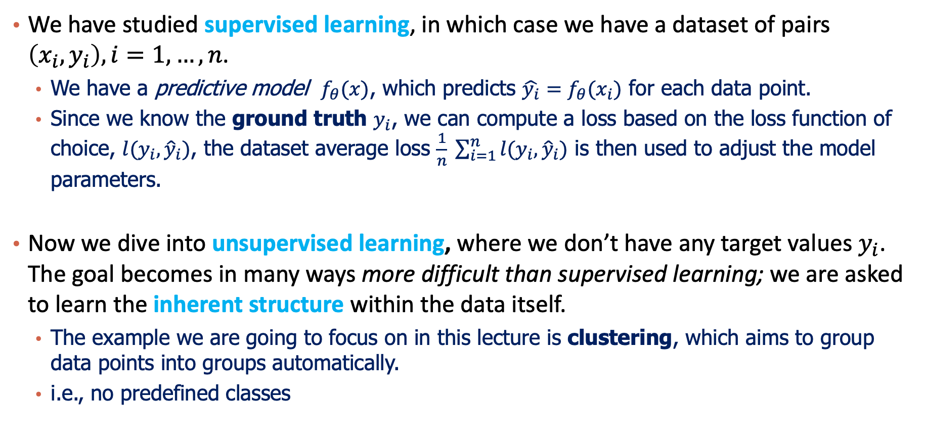
Supervised vs. Unsupervised Learning
We have studied supervised learning, in which case we have a dataset of pairs $\left(x_{i},y_{i}\right), i=1,…,n$.
We have a predictive model $f_{θ}(x)$, which predicts $\hat{y_{i}}=f_{θ}(x_{i})$ for each data point.
Since we know the ground truth $y_{i}$, we can compute a loss based on the loss function of choice, $l(y_{i},{\hat{y}}_{i})$, the dataset average loss $\frac{1}{n} \sum_{i=1}^{n}{l(y_{i},{\hat{y}}_{i})}$ is then used to adjust the model parameters.
Now we dive into unsupervised learning, where we don’t have any target values $y_{i}$. The goal becomes in many ways more difficult than supervised learning; we are asked to learn the inherent structure within the data itself.
The example we are going to focus on in this lecture is clustering, which aims to group data points into groups automatically.
i.e., no predefined classes

Slide 7
What is Cluster Analysis?
Cluster: A collection of data objects
similar (or related) to one another within the same group
dissimilar (or unrelated) to the objects in other groups
Cluster analysis (or clustering)
Finding similarities between data according to the characteristics found in the data and grouping similar data objects into clusters
Typical applications
As a stand-alone tool to get insight into data distribution
As a preprocessing step for other algorithms

Slide 8
Applications of Cluster Analysis
Data reduction
Summarization: Preprocessing for regression, classification, and association analysis
Compression: Image processing
Prediction based on groups
Cluster & find characteristics/patterns for each group
Finding K-nearest Neighbors
Localizing search to one or a small number of clusters
Outlier detection: Outliers are often viewed as those “far away” from any cluster

Slide 9
Clustering: Application Examples
Biology: taxonomy of living things: kingdom, phylum, class, order, family, genus and species
Information retrieval: document clustering
Land use: Identification of areas of similar land use in an earth observation database
Marketing: Help marketers discover distinct groups in their customer bases, and then use this knowledge to develop targeted marketing programs
City-planning: Identifying groups of houses according to their house type, value, and geographical location
Earth-quake studies: Observed earthquake epicenters should be clustered along continent faults
Climate: understanding earth climate, find patterns of atmospheric and ocean
Finance: volatility clustering for stock trading days.

Slide 10
Outline
Clustering Analysis: Basic Concepts
K-means
Hierarchical Methods
*DBSCAN
Summary

Slide 11
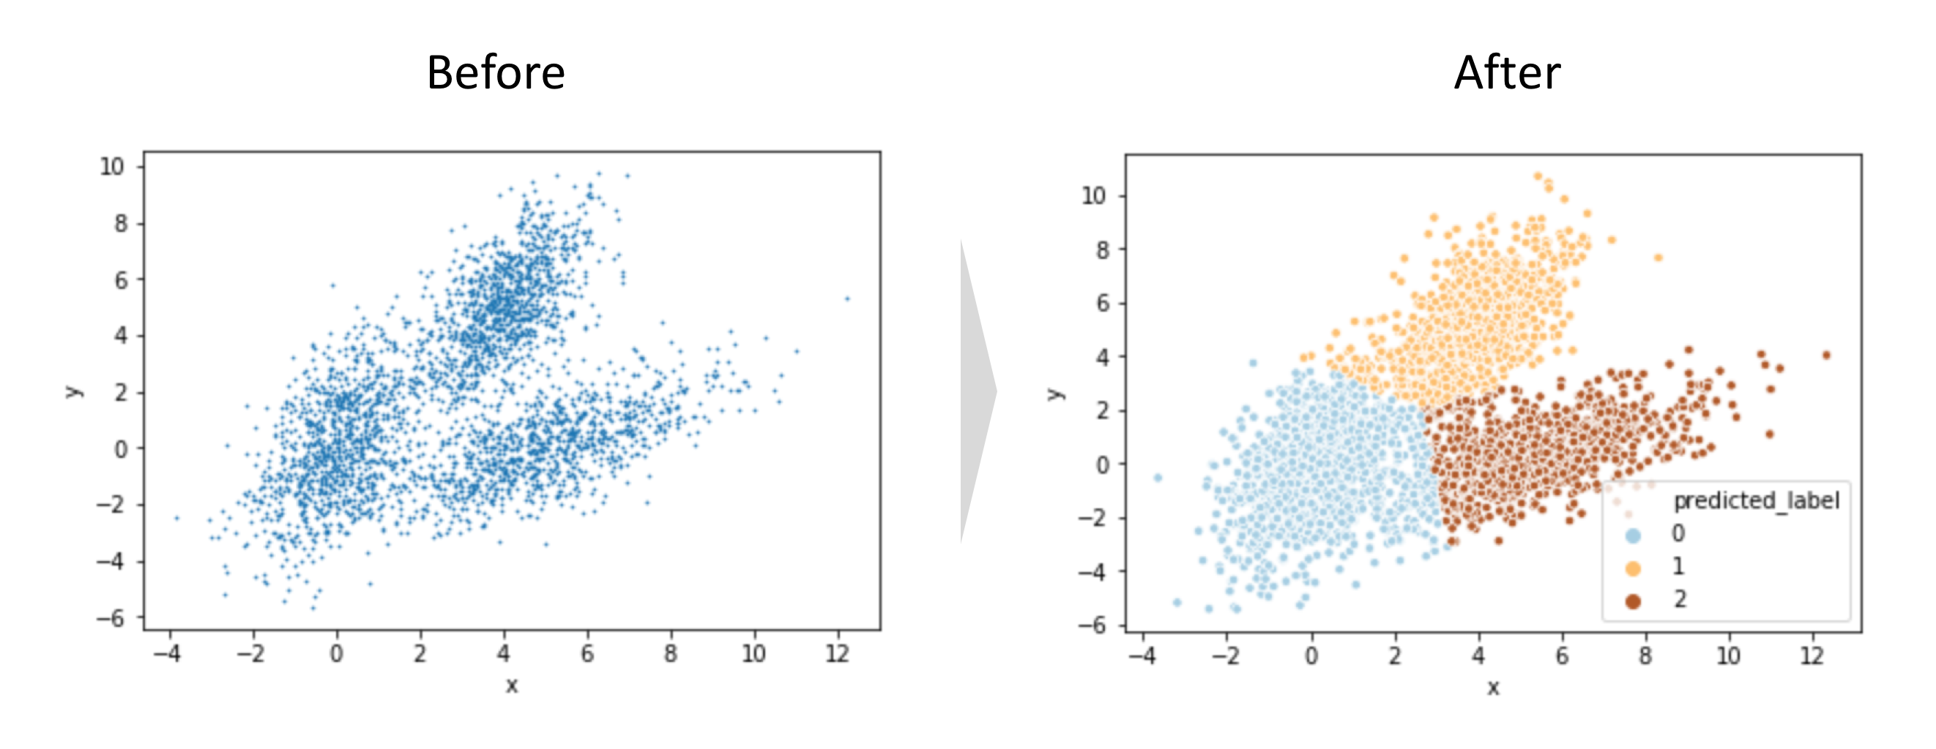
What does “partition” mean
Partition: Divide the space into different portions
Automatic Detection of “local structures of data”

Slide 12
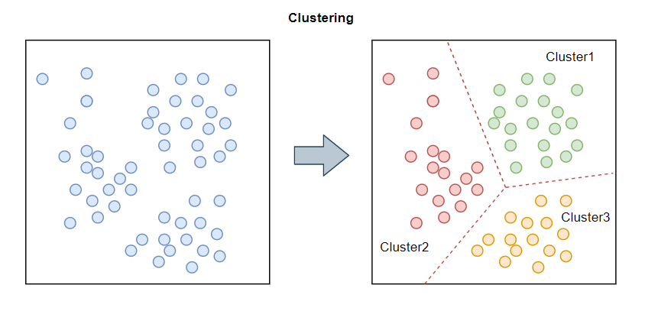
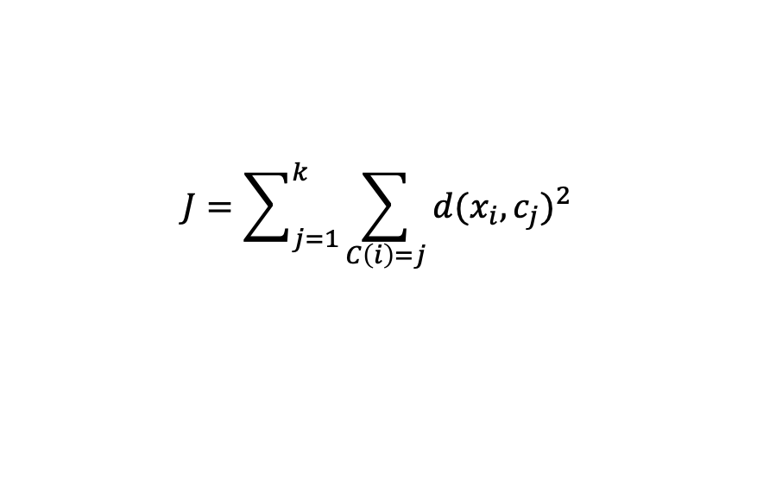
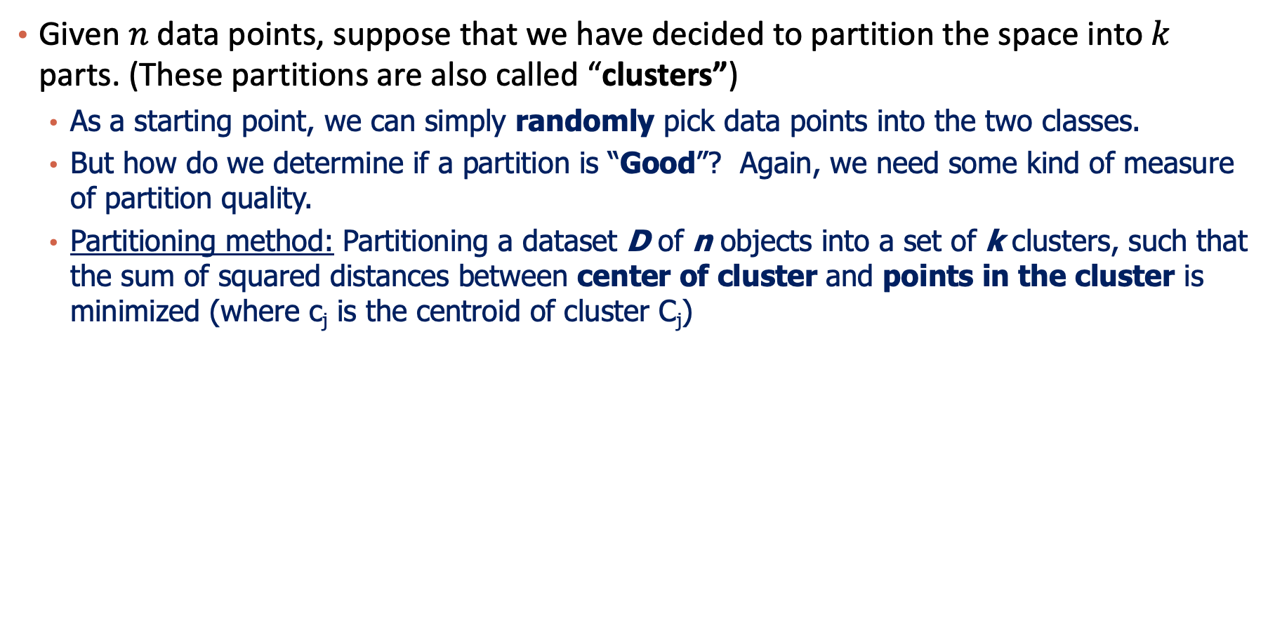
How to Partition?
Given $n$ data points, suppose that we have decided to partition the space into $k$ parts. (These partitions are also called “clusters”)
As a starting point, we can simply randomly pick data points into the two classes.
But how do we determine if a partition is “Good”? Again, we need some kind of measure of partition quality.
Partitioning method: Partitioning a dataset D of n objects into a set of k clusters, such that the sum of squared distances between center of cluster and points in the cluster is minimized (where c_{j} is the centroid of cluster C_{j})
$$J=\sum_{j=1}^{k}{\sum_{C\left(i\right)=j}{{d(x_{i}, c_{j})}^{2}}}$$

Slide 13
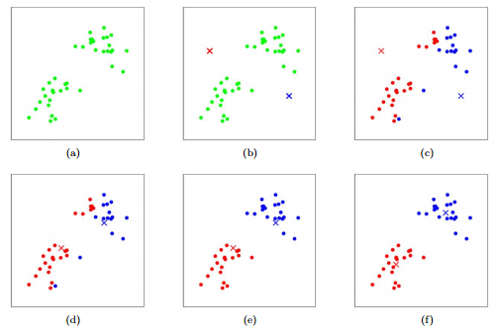

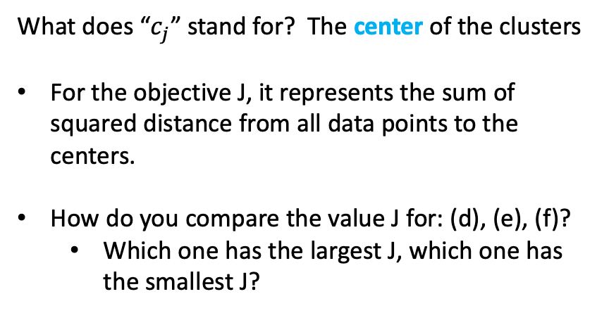
Let’s See What it Means
$$J=\sum_{j=1}^{k}{\sum_{C\left(i\right)=j}{{d(x_{i}, c_{j})}^{2}}}$$
What does “$c_{j}$” stand for? The center of the clusters
For the objective J, it represents the sum of squared distance from all data points to the centers.
How do you compare the value J for: (d), (e), (f)?
Which one has the largest J, which one has the smallest J?

Slide 14
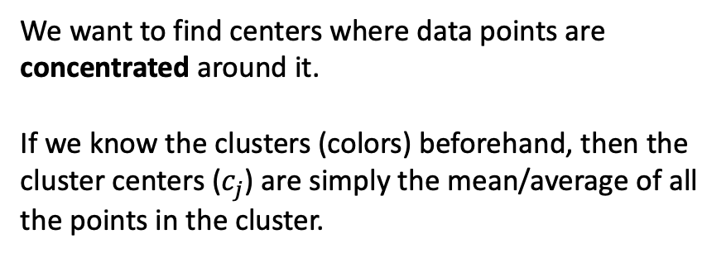
Let’s See What it Means
$$J=\sum_{j=1}^{k}{\sum_{C\left(i\right)=j}{{d(x_{i}, c_{j})}^{2}}}$$
We want to find centers where data points are concentrated around it.
If we know the clusters (colors) beforehand, then the cluster centers ($c_{j}$) are simply the mean/average of all the points in the cluster.

Slide 15



Please download and install the Slido app on all computers you use
Suppose there are 100 points. How many ways to arrange them into 2 clusters?
ⓘ Start presenting to display the poll results on this slide.

Slide 16

K-means objective
Partitioning method: Partitioning a dataset D of n objects into a set of k clusters, such that the sum of squared distances is minimized (where c_{j} is the centroid of cluster C_{j})
Given k, find a partition of k clusters that optimizes the chosen partitioning criterion
Global optimal: exhaustively enumerate all partitions
Heuristic methods: k-means. Iteratively find k clusters.
$$J=\sum_{j=1}^{k}{\sum_{C\left(i\right)=j}{{d(x_{i}, c_{j})}^{2}}}$$

Slide 17
The K-Means Clustering Method
Given k, the k-means algorithm is implemented in four steps:
Step 0: Randomly assign k seed points as the cluster centroids
Step 1: Assign each data point to the cluster with the nearest seed point to partition the data
Step 2: Compute the new centroids of the clusters of the current partitioning (the centroid is the center, i.e., mean point, of the cluster)
Step 3: Go back to Step 1, stop when the assignment does not change

Slide 18
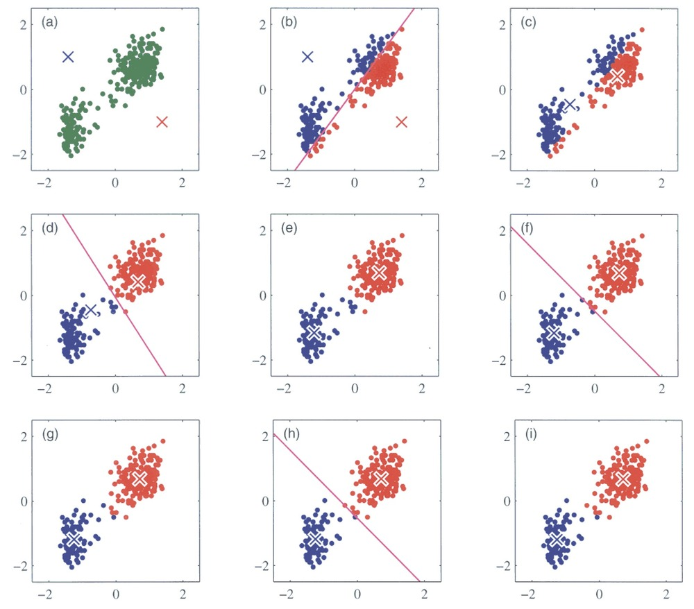
K-means example

Slide 19
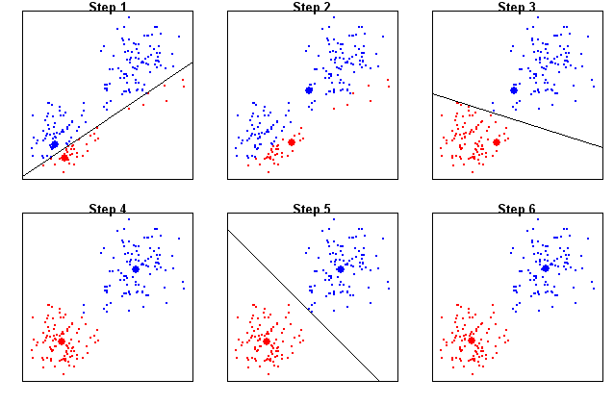
K-means example

Slide 20
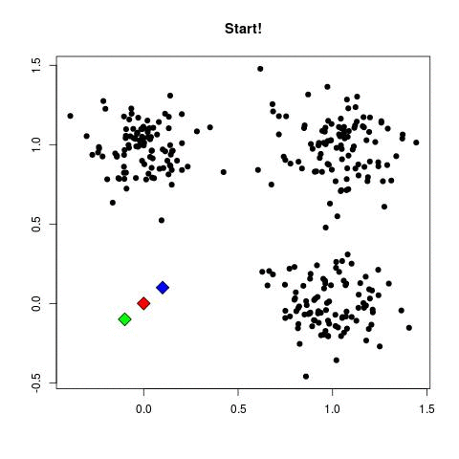
K-means example

Slide 21

K-means example
Play with KMeans: https://www.naftaliharris.com/blog/visualizing-k-means-clustering/

Slide 22
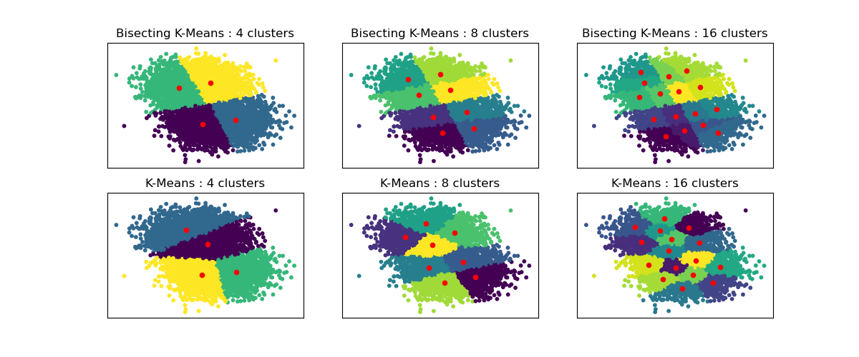
Hyperparameter: number of clusters (K)

Slide 23
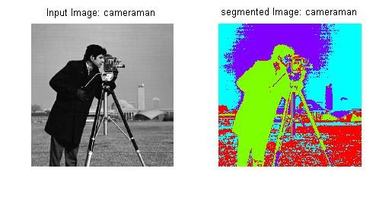
K-means Example: Image Segmentation

Slide 24
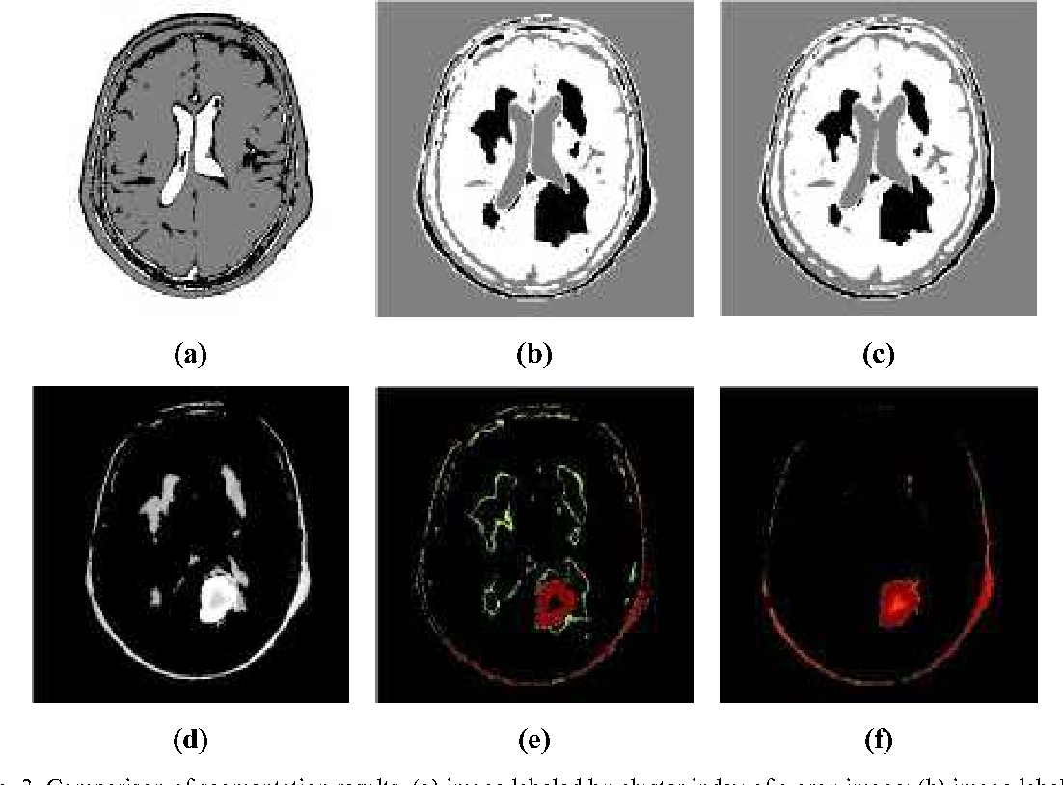
K-means Example: brain scan

Slide 25

Please download and install the Slido app on all computers you use
Audience Q&A Session
ⓘ Start presenting to display the audience questions on this slide.

Slide 26
Outline
Clustering Analysis: Basic Concepts
K-means
Hierarchical Methods
*DBSCAN
Summary

Slide 27
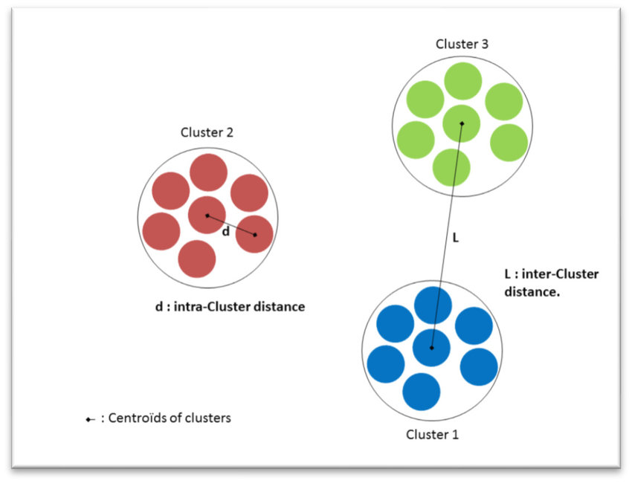
Distance between clusters
How to measure the distance between two clusters?

Slide 28
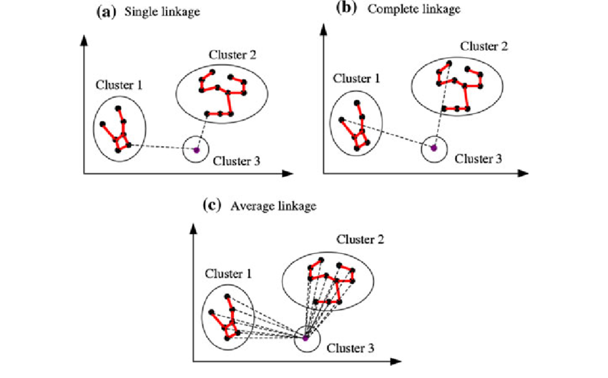
Distance between clusters
How to measure the distance between two clusters?
Distances to
Closest point (single linkage)
Farthest point (complete linkage)
Average of all points (Average linkage)

Slide 29
Bottom-up Hierarchical Clustering
Take points that are close-by as a cluster.
Merge clusters that are close-by into new “super clusters”
Repeat the above until we have the desired number of clusters.
Or some termination condition is met
Step 0
Step 1
Step 2
Step 3
Step 4
agglomerative
(AGNES)
a
a b
b
a b c d e
c
c d e
d
d e
e
divisive
(DIANA)
Step 4
Step 3
Step 2
Step 1
Step 0

Slide 30
Pseudo Code
Initialization: Place each data point into its own cluster and compute distance matrix between clusters
Repeat:
Merge the two closest clusters
Update the distance matrix for the affected entries
Until: all the data are merged into a single cluster

Slide 31
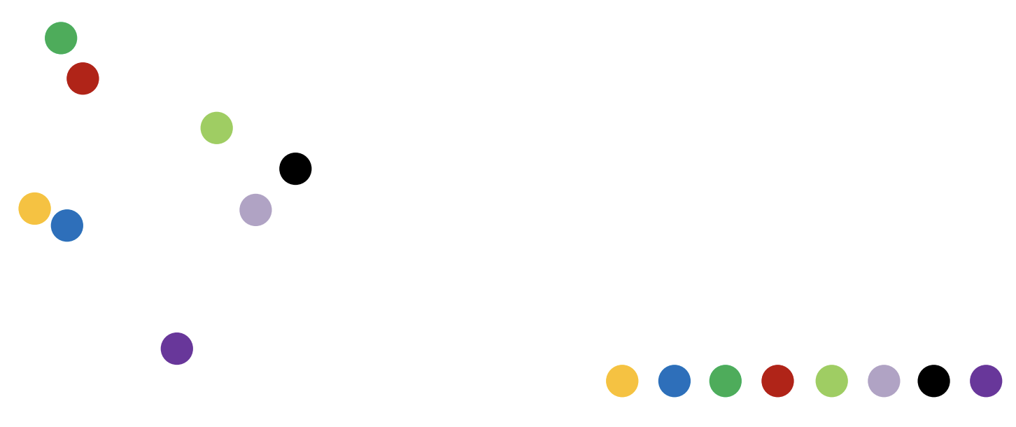
Hierarchical Clustering

Slide 32
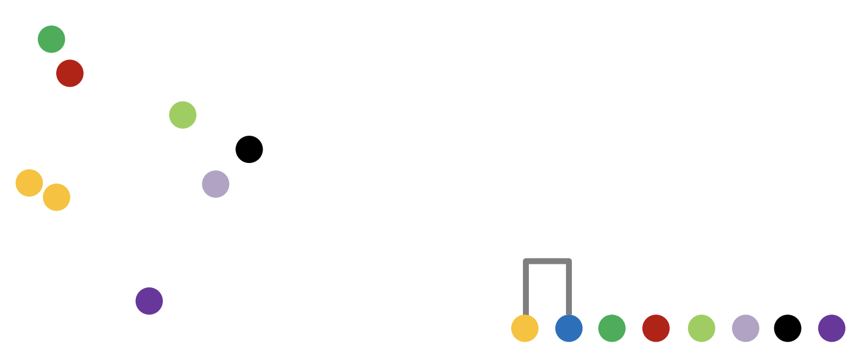
Hierarchical Clustering

Slide 33
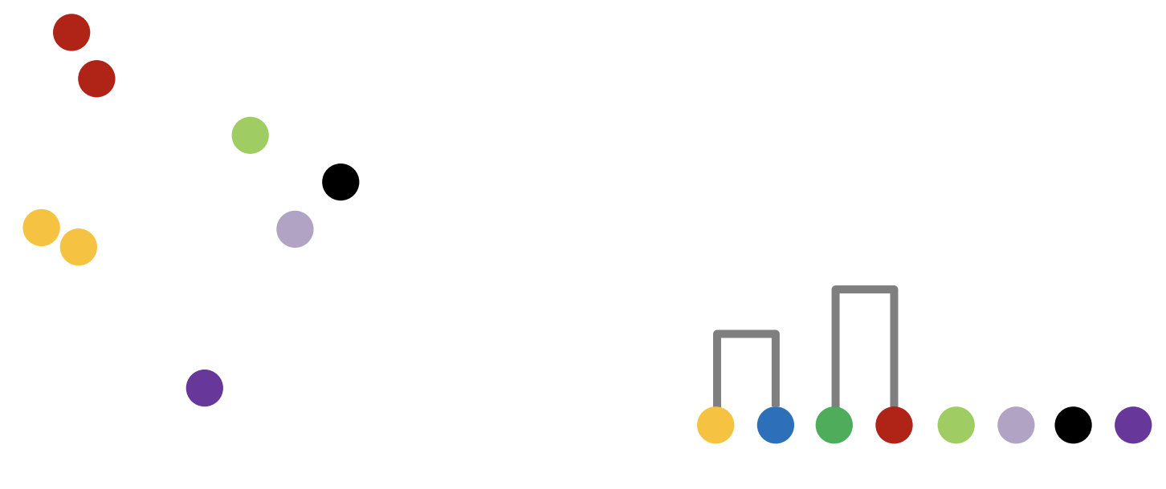
Hierarchical Clustering

Slide 34
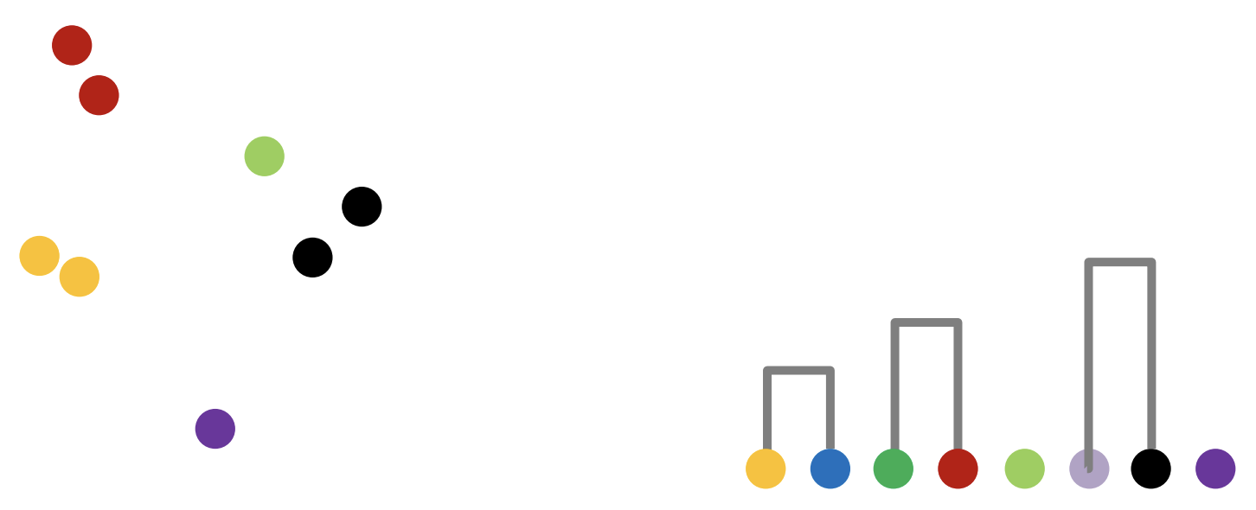
Hierarchical Clustering

Slide 35
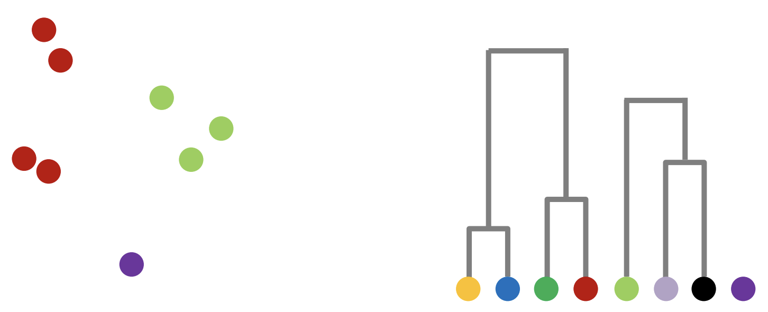
Hierarchical Clustering

Slide 36
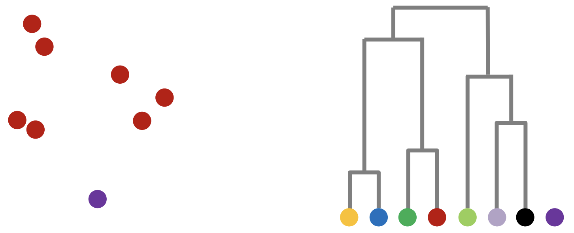
Hierarchical Clustering

Slide 37
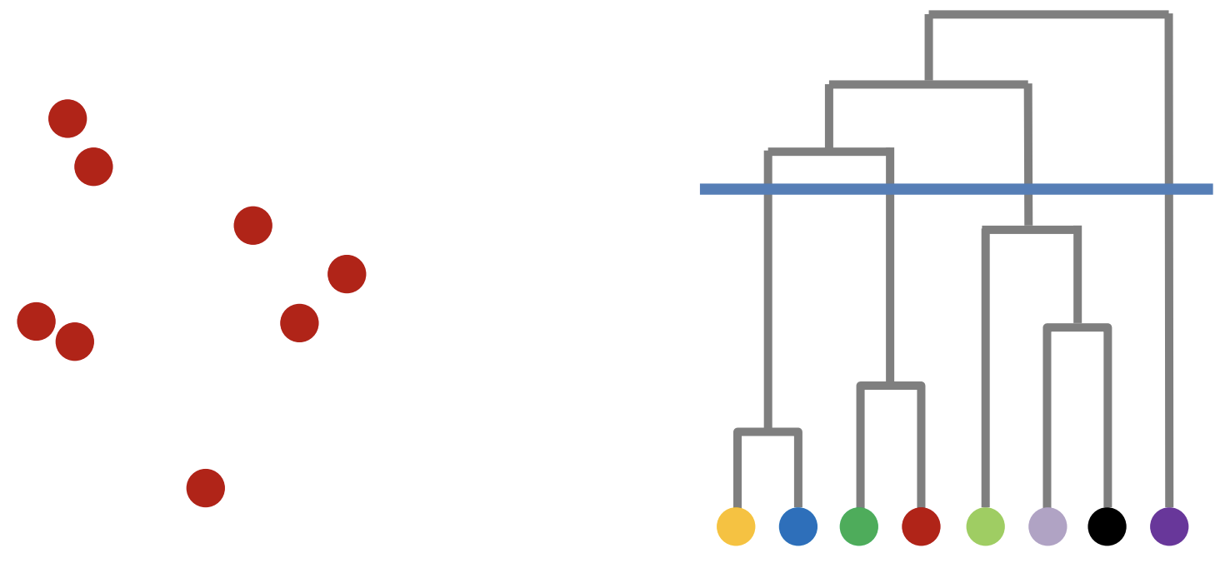
Hierarchical Clustering

Slide 38
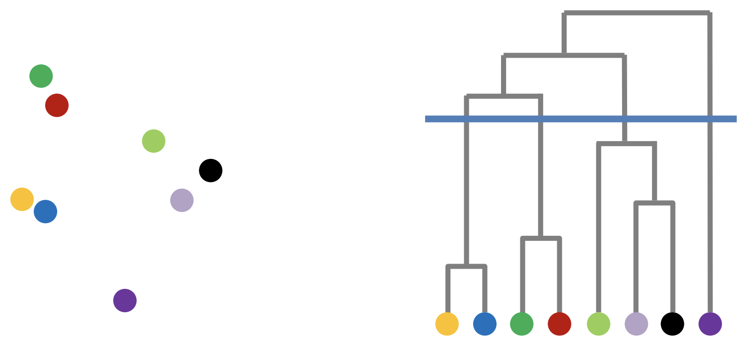
Hierarchical Clustering

Slide 39
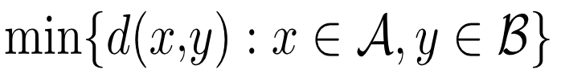
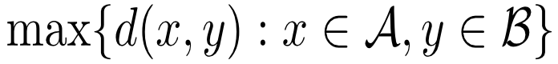
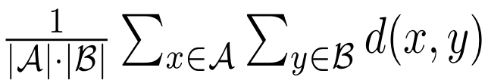
Hierarchical Clustering
Produces complete structure
No predefined number of clusters
Similarity between clusters:
single-linkage:
complete-linkage:
average linkage:

Slide 40
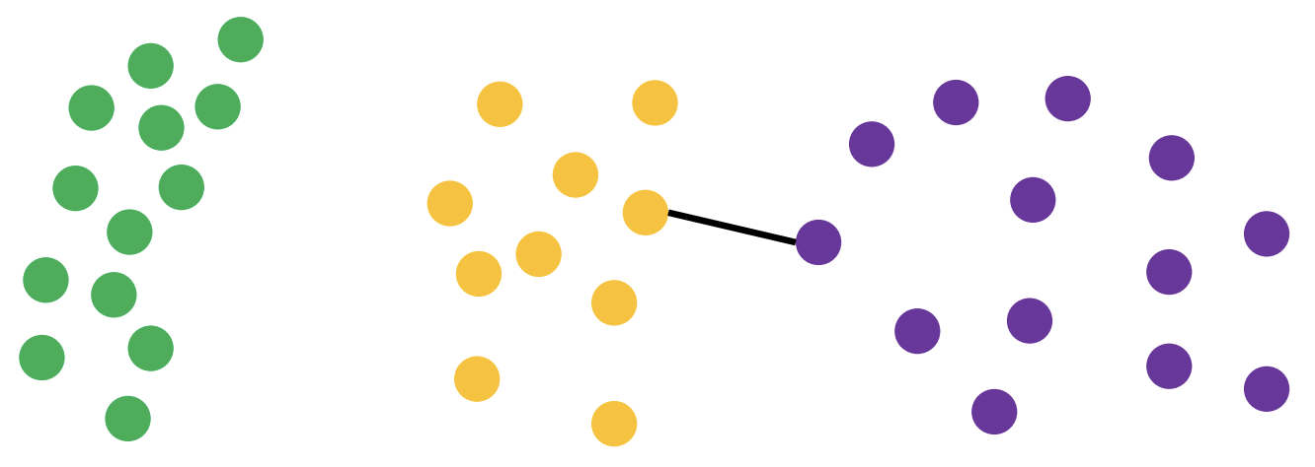
Single Linkage

Slide 41
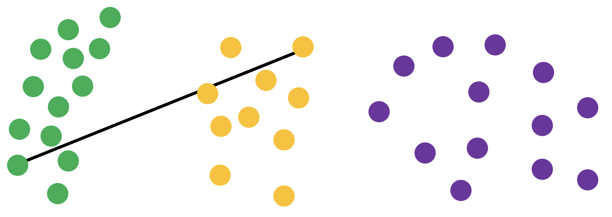
Complete Linkage

Slide 42
Linkage Matters
Single linkage: Tendency to form long chains
Complete linkage: Sensitive to outliers
Average-link: Trying to compromise between the two

Slide 43
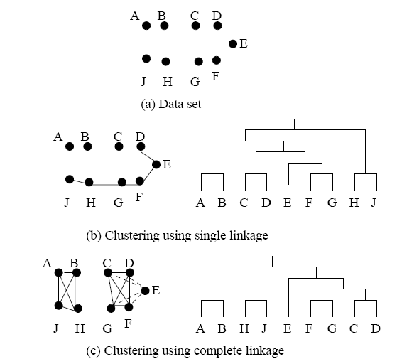
Example: Single Link vs. Complete Link

Slide 44
Please download and install the Slido app on all computers you use
Audience Q&A Session
ⓘ Start presenting to display the audience questions on this slide.

Slide 45
Outline
Clustering Analysis: Basic Concepts
K-means
Hierarchical Methods
*DBSCAN
Summary

Slide 46
Density-Based Clustering Methods
Clustering based on density (local cluster criterion), such as density-connected points
Major features:
Discover clusters of arbitrary shape
Handle noise
One scan
Need density parameters as termination condition
Several interesting studies:
DBSCAN: Density-Based Spatial Clustering of Applications with Noise Ester, et al. (KDD’96)
OPTICS*: Ankerst, et al (SIGMOD’99).
DENCLUE*: Hinneburg & D. Keim (KDD’98)
CLIQUE*: Agrawal, et al. (SIGMOD’98) (more grid-based)

Slide 47

DBSCAN: can detect clusters with arbitrary shapes

Slide 48
DBSCAN: Basic Concepts
Two parameters:
Eps : Maximum radius of the neighborhood
MinPts : Minimum number of points in an Eps-neighborhood of that point
N_{Eps}(q): {p | dist(p,q) ≤ Eps}
q is a core point if:
|N_{Eps} (q)| ≥ MinPts
Directly density-reachable: A point p is directly density-reachable from a point q w.r.t. Eps, MinPts if
q is a core point
p belongs to N_{Eps}(q)
p
MinPts = 5
Eps = 1 cm
q

Slide 49
Density-Reachable and Density-Connected
Density-reachable:
A point p is density-reachable from a point q w.r.t. Eps, MinPts if there is a chain of points p₁, …, p_{n}, p₁ = q, p_{n} = p such that p_{i+1} is directly density-reachable from p_{i}
Density-connected
A point p is density-connected to a point q w.r.t. Eps, MinPts if there is a point o such that both, p and q are density-reachable from o w.r.t. Eps and MinPts
p
p₂
q
p
q
o

Slide 50
DBSCAN: Density-Based Spatial Clustering of Applications with Noise
Relies on a density-based notion of cluster: A cluster is defined as a maximal set of density-connected points
Noise: object not contained in any cluster is noise
Discovers clusters of arbitrary shape in spatial databases with noise
Noise
Border
Eps = 1cm
MinPts = 5
Core

Slide 51
Core points, border points and noises
Density-based spatial clustering of applications with noise (DBSCAN)
groups together points that are closely packed together
Outlier points: noise (low-density region)

Slide 52
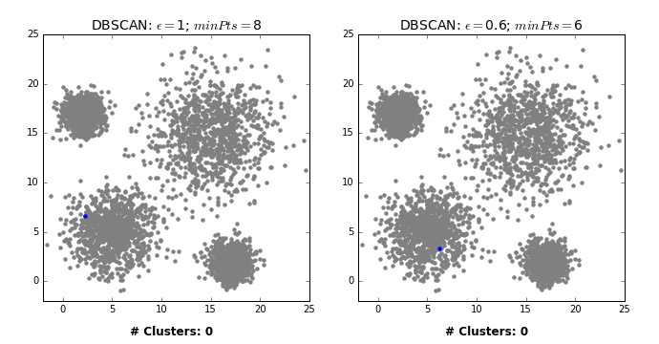
DBSCAN: sensitive to minpts

Slide 53
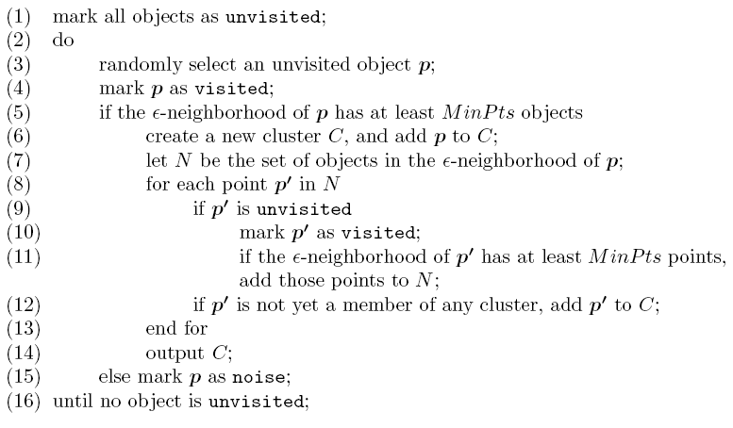
DBSCAN: The Algorithm
If a spatial index is used, the computational complexity of DBSCAN is O(nlogn), where n is the number of database objects. Otherwise, the complexity is O(n²)

Slide 54
DBSCAN: sensitive to eps

Slide 55
K-means vs DBSCAN

Slide 56
Outline
Clustering Analysis: Basic Concepts
K-means
Hierarchical Methods
DBSCAN
Summary

Slide 57
Summary
Cluster analysis groups objects based on their similarity and has wide applications;
K-means algorithm is a popular partitioning-based clustering algorithm
hierarchical clustering algorithms
DBSCAN is a density-based algorithm

Slide 58
Please download and install the Slido app on all computers you use
Audience Q&A Session
ⓘ Start presenting to display the audience questions on this slide.

